Slide 1



Run Like a Neural Network, Explain Like k-Nearest Neighbor
Keywords: XAI, CBR, Neurosymbolic, Interpretable AI
Xiaomeng Ye,
David Leake,
Yu Wang,
David Crandall

Slide 2
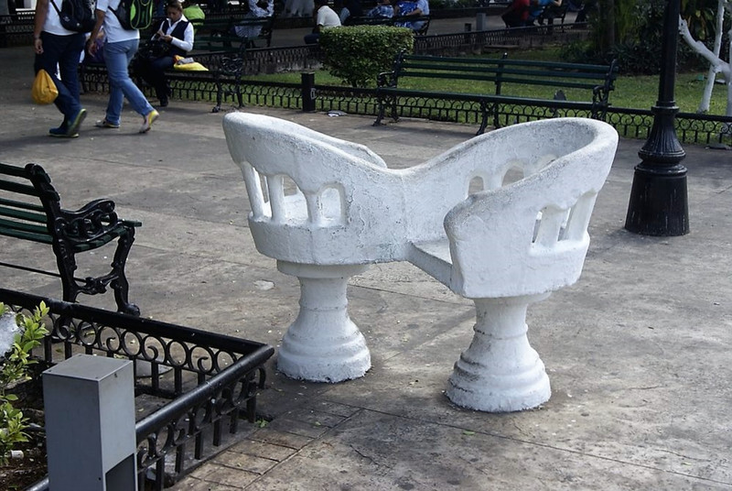
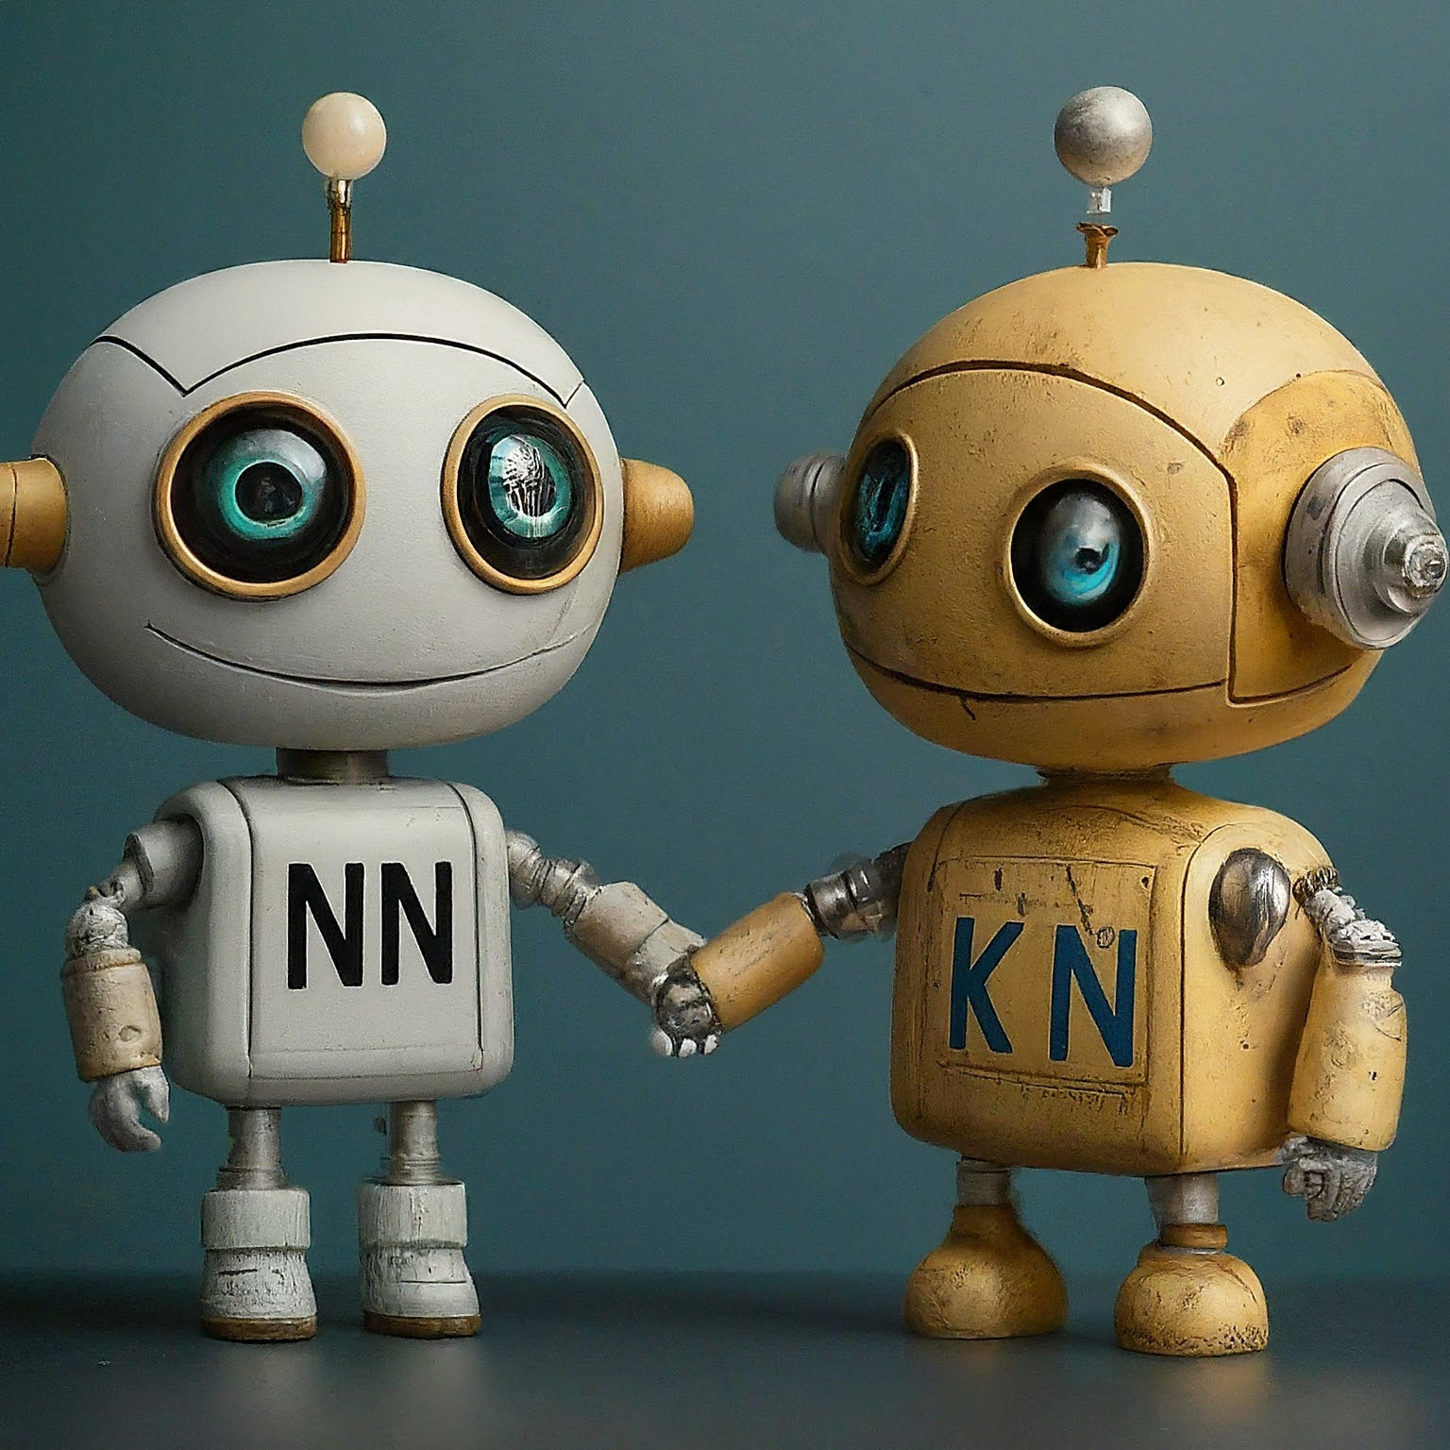
In Brief
We build a neural network that operates just like a k-nearest neighbor system. (NN-kNN)
It runs as a neural network: Trainable through backprop. Compatible with other neural models.
Its layers and nodes mimic k-nearest neighbor: Its decisions are interpreted/explained by activated cases and features.

Slide 3
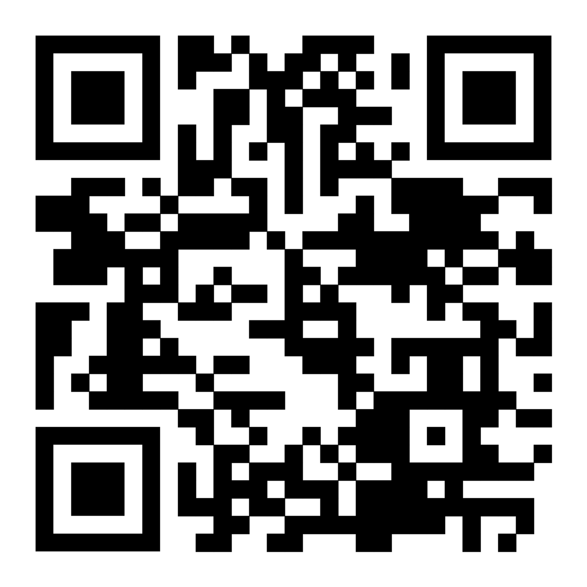
Overview
This presentation answers six questions:
Why develop NN-kNN?
How to build it?
What's the benefit of using it?
How well does it work?
What's the downside?
What's down the road?
Given the time constraint we will skip details of technical implementation and results. Please see paper or poster later.

Slide 4
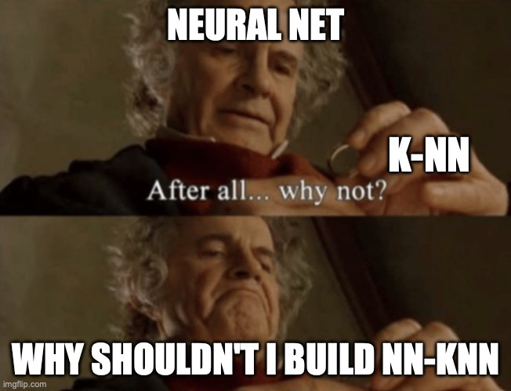
Why?
K-NN: k-nearest neighbor. Classify a query by finding its k nearest neighbors, and use the retrieved cases' labels.

Slide 5
Why?
Neural networks are powerful but black-box
K-NN is transparent but ill-suited to high-dimensional data
We want to combine the two and harness the strengths of both.
 | k-NN | Neural Networks
Strengths | Competitive accuracy on easy datasets; simple and transparent reasoning process. | Captures abstract patterns and feature interaction; handles large, high-dimensional data efficiently.
Limitations | Difficulty with large/high-dimensional data; performance depends heavily on metric & feature selection. | Black box. Requires post-hoc explanations, which may not reflect true reasoning.

Slide 6
Why NN-kNN? A. Advantages over traditional k-NN
Neural networks have many benefits over traditional k-NN implementations:
Training scheme (minimizing loss), network structures (for feature extraction, hidden pattern learning), parallel computing (fast in training), active learning (fast in testing), can chain with other neural network modules (CNN + classifier)

Slide 7
Why NN-kNN? B. Advantage over NNs for Interpretability
K-NN is fully interpretable, NNs are (usually) black box.
Each k-NN solution is supported by selected nearest cases.
The core k-NN computation is a simple human-understandable distance calculation
From the perspective of case-based reasoning, identifying cases contributing to solution may be sufficient interpretability (Gates, Leake, Wilkerson 23).
Feature weights can provide additional information

Slide 8
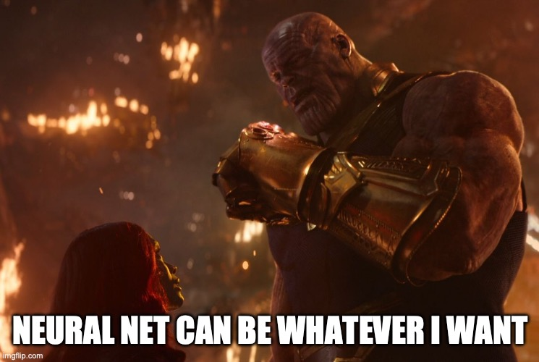
How?
Neural Nets are universal approximators. So we can emulate almost any function (with limited memory).
A good example: Logical Neural Net (Nodes represent logical operations)
We can emulate a k-NN with a NN.
We will show how it works in classification.

Slide 9
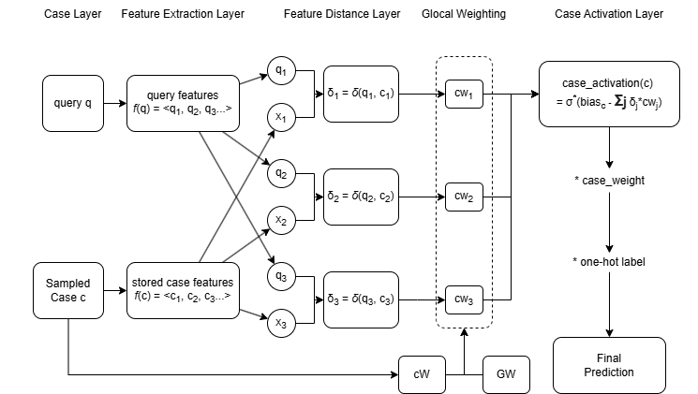
Neural Network Based K-Nearest Neighbor

Slide 10

1. Sampling cases to compare. We use equal number of cases from each class

Slide 11

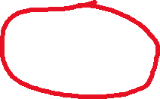
2. Extract Features. ResNet, Doc2Vec, Transformers, surface features, CNN, Bi-LSTM...

Slide 12

3. Calculate Feature Distance. Euclidean distance, cosine distance.

Slide 13

4. Weight each feature distance

Slide 14
Why do we weight features?
 | Global Importance | Local Importance
Meaning | Feature is consistently important across the whole dataset. | Feature importance varies depending on the local region or specific case.
Example | In house price prediction: number of rooms is generally predictive. | In coastal regions: distance to shore is crucial; inland, proximity to schools might matter more.
Implementation | Shared global feature weights applied to all cases. | Case-specific feature weights. Each case has its own set of feature weights.
Problem | Ignores local landscape | Too many parameters (each case could have its own feature weighting). Prone to overfit.

Slide 15
Global-Local (Glocal) Feature Weighting
We create a middle ground between global and local weighting
w global feature weights GW={GW1, GW2, ..., GWw}, a matrix of w x d
Each set GWi ={Wi1, Wi2, ..., Wid}, d is the number of features
The scaler Wij represents the importance of feature j according to GWi
Each case c has coefficients cW = {cW1, cW2, ..., cWw}, a matrix of 1 x w
cWi quantifies how strongly case c is influenced by GWi.
The feature weight for case c is: cw = cW · GW, it has dimension 1 x d
Intuitively, each case choose how much it takes from each GWi

Slide 16
Example for Global-Local Feature Weighting
Using house price prediction as an example.
Let's say there are three features: {number of rooms, distance to shore, and proximity to school}
We can have two GW={GW1, GW2}, where GW1 ={0.8,0,0.2}, GW2= {0.4,0.6,0}
If c is by the sea, then cW could be {0.3,0.7}
cw = cW · GW = 0.3×{0.8,0,0.2}+0.7×{0.4,0.6,0}={0.52,0.42,0.06}

Slide 17
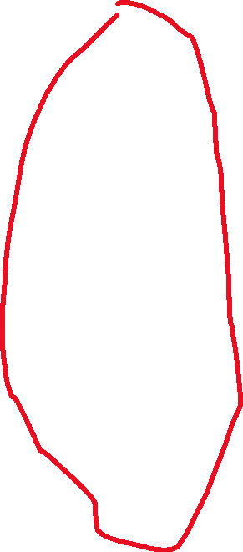
4. Weight each feature distance

Slide 18
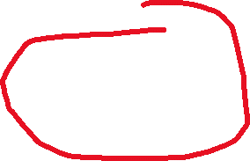
5. Calculate case activation based on distance

Slide 19
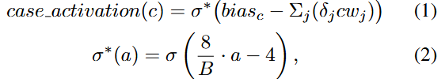
Case activation function
Each case has a learnable default activation biasc
The case activation is biasc reduced by the weighted distance from the query, passed through a scaled sigmoid.
We initialize biasc as the average unweighted distance B of the k-th nearest neighbor in all cases.
biasc is trainable. B remains fixed.

Slide 20
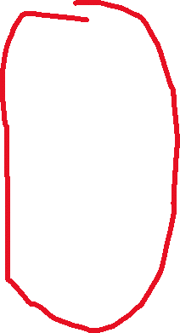
6. Activate the corresponding classes

Slide 21
Intuitive Explanation
NN-kNN is composed of:
A layer that calculates feature distances
A layer that calculates case activations using feature distances
(case activation really is just the inverse of case distance)
A layer that activates classes based on activated cases
A final layer to summarize/adapt all classes

Slide 22
Summary of NN-kNN
NN-kNN implements a generalized k-NN. It has:
Local/global weighting for feature weighting
Case weighting
Default case activation (determined by k)
User may disable any of the above, by setting the corresponding parameters to a fixed constant value.
User may also chain additional modules for different purposes, E.g. adding a feature extraction module at the front, or modifying the target/adaptation layer at the end for a special adaptation rule.

Slide 23
Comparison with old NN-kNN
Scalable by sampling cases
Feature Extraction, allows evaluation on Image and Text
Global-local feature weighting mechanism
Custom case activation function

Slide 24
Benefits of NN-kNN
Fully intrepretable as a k-NN: Can show similar features and highly activated cases.
Powerful like a normal NN: NN-kNN is trained to minimize a loss using back propagation.
Harmonizes different components. Trained end-to-end. We can train feature weighting and case weighting together; We can balance the loss between accuracy and explainability; We can also train feature extraction, retrieval (and even adaptation) together.

Slide 25
Evaluation
Does NN-kNN provide accuracy comparable to other models?
Are the cases activated by NN-kNN good explanations for the model’s final decision? Potentially, NN-kNN as a neural network could make correct predictions for the wrong reasons

Slide 26
Evaluation: Simple Classification
Compared with other kNN methods: an older version of NN-kNN using either global or local weighting, a vanilla k-NN, Neighborhood Components Analysis (NCA) and Large Margin Nearest Neighbor (LMNN). NCA and LMNN can be considered as state-of-the-art k-NN methods.
Also compared to a neural net of similar complexity.
Parameter settings are in paper

Slide 27
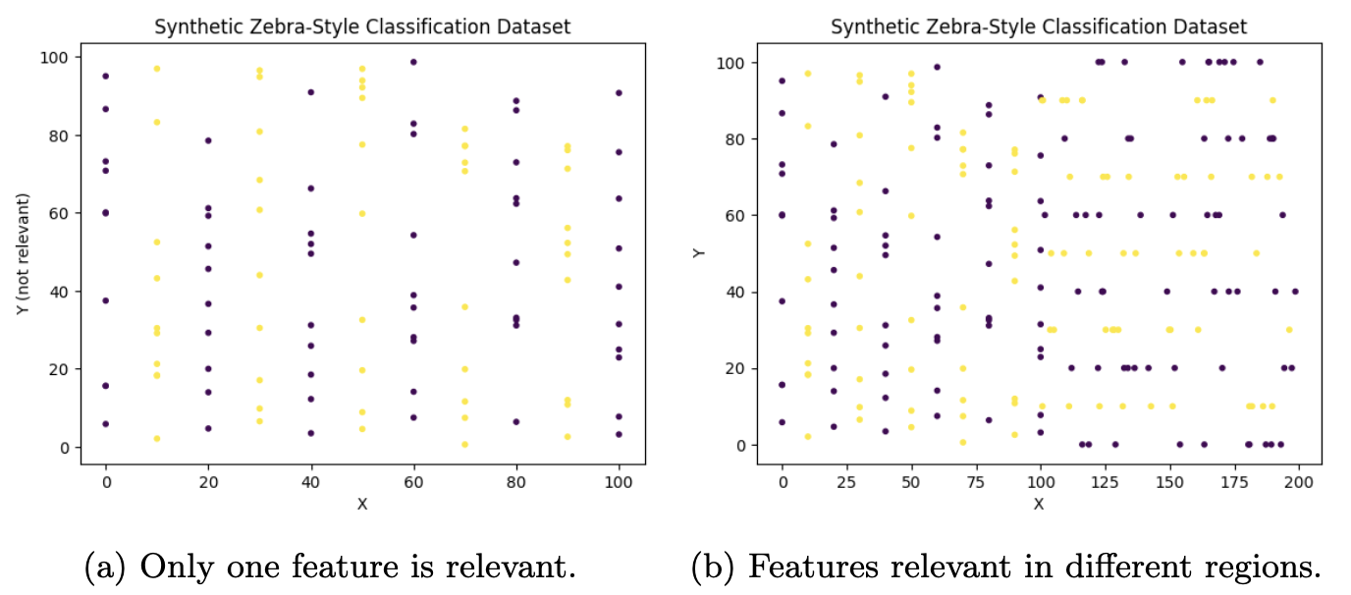
Evaluation: Simple Classification
Data sets: Sample small standard tabular data sets, for classification and regression.
Two additional generated dataset (zebra patterns shown top right)
Zebra (a), only feature X is important while Y is irrelevant
Zebra (b), X is important when X < 100, and Y is important when X > 100.
They test models' ability to learn a local weighting (local landscape).

Slide 28
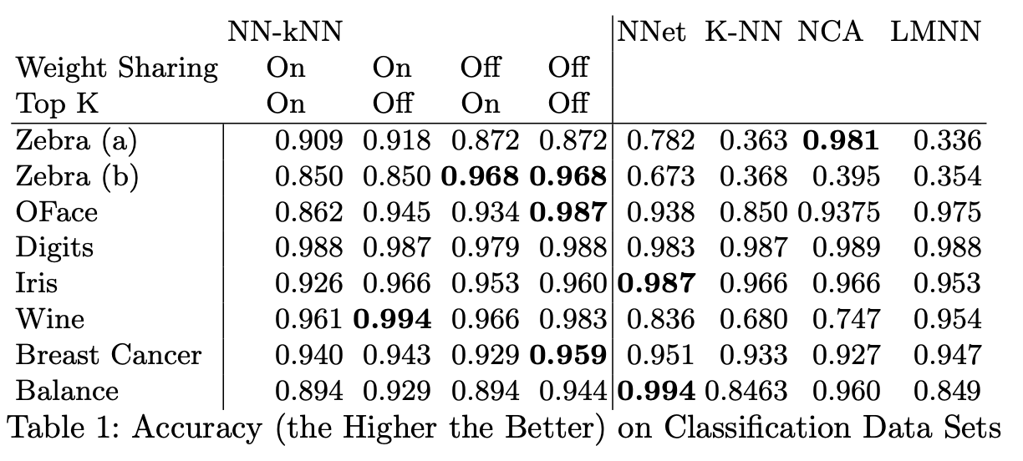
Results on classification data sets for older NN-kNN
Previous results from "Towards network implementation of cbr: Case study of a neural network k-nn algorithm"

Slide 29
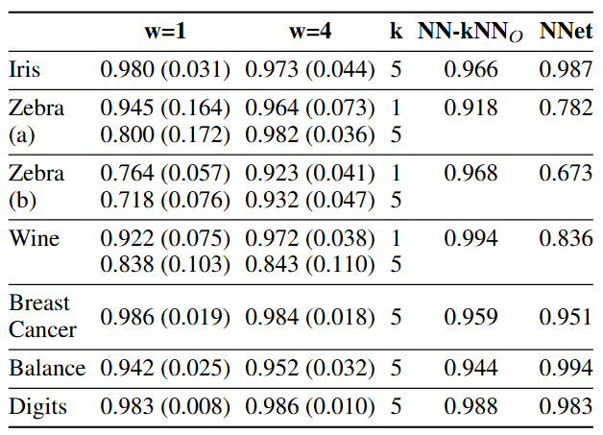
Results on classification data sets for new NN-kNN
Older NN-kNN generally outperform or on par with other models
New NN-kNN outperforms older NN-kNN
Increasing w consistently improves the performance.
The choice of k (which influenced biasc) has a significant impact on performance.

Slide 30
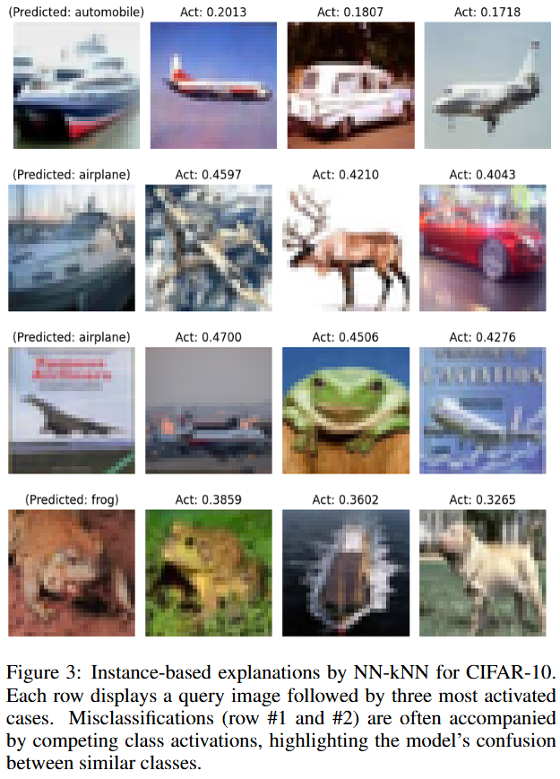
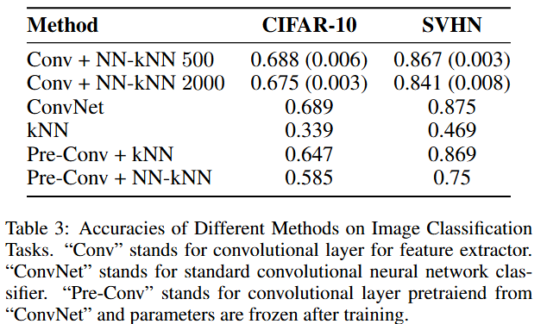
Evaluation: Image Classification

Slide 31
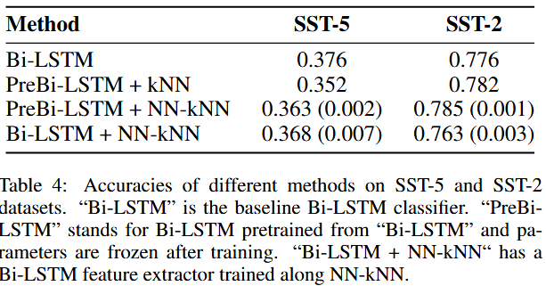
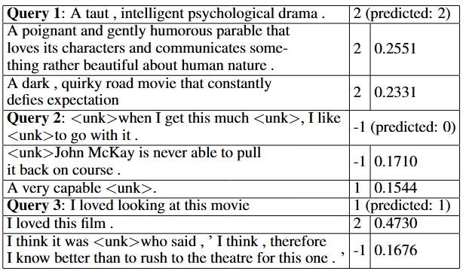
Evaluation: Movie Review Sentiment Classification

Slide 32
Discussion: The Good. NN-kNN is effective and interpretable
NN-kNN is inherently a neural network with preset neurons (in the case layer), connections (e.g. one case only activates a corresponding class) and preset-but-tunable parameters (weights and biases).
NN-kNN effectively combines general pattern knowledge (weights and bias) and symbolic case knowledge, and scales without sacrificing accuracy.
It allows benefits from both sides. For example:
Can explain with features and cases. Allow manual control/debugging with cases/features!
Allow easy incremental learning.
Easily compatible with neural methods (optimization, latent space modeling, regularization techniques)

Slide 33
Discussion: The Interesting I
For models operating on high-dimensional feature spaces, the luxury of abundant feature dimensions diminishes the utility of w. In other words: if you have very strong feature extractor, you just need one set of global feature weighting.

Slide 34
Discussion: The Interesting II
NN-kNN carries a risk of overfitting when paired with a pre-trained feature extractor, often underperforming compared to a vanilla k-NN using the same extractor.
Because pre-trained extractors are not optimized for instance-based reasoning
Notably, this risk is mitigated when the feature extractor is trained jointly with NN-kNN from scratch, ensuring better alignment with instance-based reasoning objectives.

Slide 35
Discussion: The Bad
It inherits downside from both NN and kNN.
(Meta-)Parameters needs some fine tuning.
Cases are interpretable, but the neural part is not. If using too strong a feature extractor, we black-box (part of) the white box again.
These issues are not fundamental, and solvable using techniques from both sides.

Slide 36
Take-aways
NN-kNN combines NN and kNN.
Inherits pros (and cons) of both sides.
Cases make models interpretable, and equally accurate (if not more).
NN-kNN illustrates new opportunities for network case-based reasoning.
Symbolic and Neural, at the same time. (more than just Symbolic + Neural)
One future direction is NN-kNN style RAG.

Slide 37

My Email (xye@berry.edu) and the Paper

